Slide 1
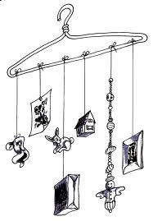
Mobile Book Report
Show your understanding of important people, events, and objects in your book by making a mobile. You will demonstrate your knowledge of the book by identifying the importance of the objects on your mobile and relating them to your book.

Slide 2
Contents
Mobile structure on which objects can be hung. Title and Author of book must be displayed clearly.
At least 8 objects that represent important people, events, or objects in the book.
On a card attached above or below each object, tell the importance of the object as it relates to the book.
Write a plot summary and your opinion of the book – no less than 1 page to be handed in as well. This should be typed double-spaced.

